Slide 1
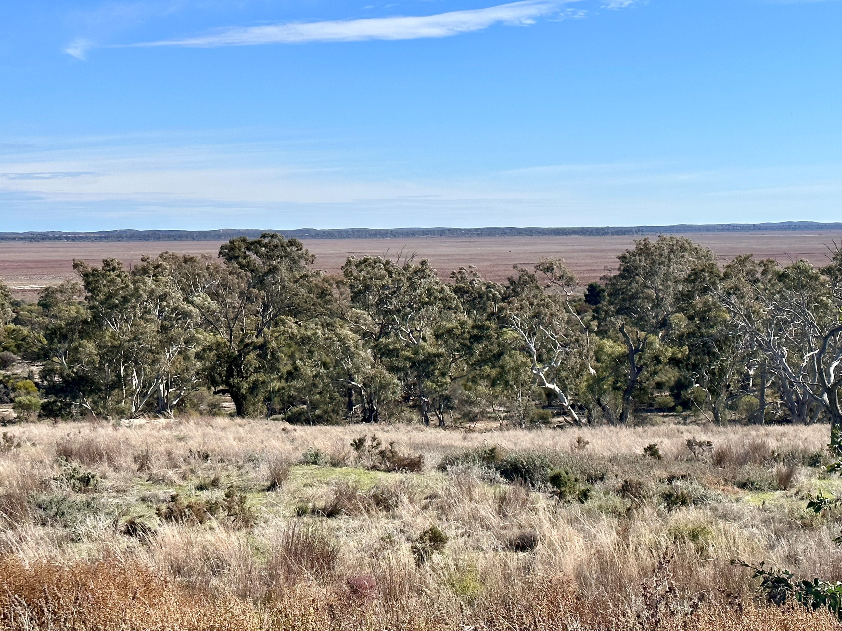
ACKNOWLEDGEMENT OF COUNTRY
​
1
Notes:
Skye
I would like to start by acknowledging the First Nations people and the lands on which we are all meeting today, acknowledging that that there are many. I pay my respects to my Elders past, present and emerging and I pay deep respect to my own Country which you see on this slide here. My Country is Wergaia Country and it is Big Sky Country. It is a Country of old gum trees, mallee scrub, red dirt and a vast blue sky. We also acknowledge and uphold the intrinsic connections and continuing relationships Aboriginal and Torres Strait Islander people have to Country and value the cultural knowledge, strength and resilience in our work to improve the lives of all people.
We will use the word Aboriginal and Torres Strait Islander as a collective term. At times Aboriginal may be used to signify both Aboriginal and Torres Strait Islander.

Slide 2
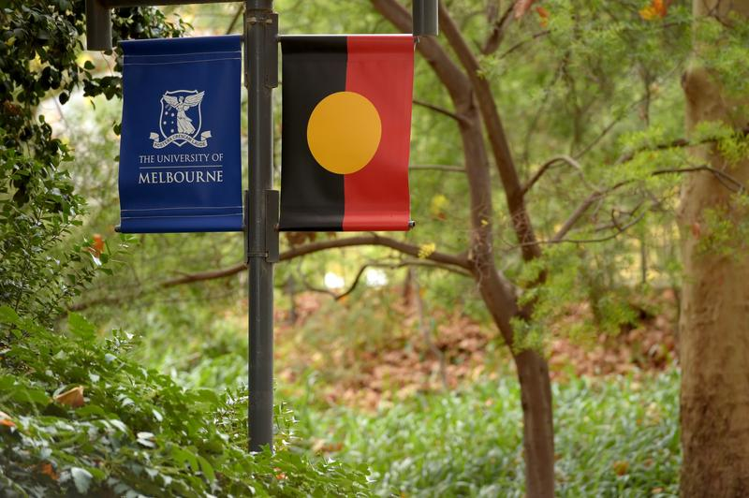
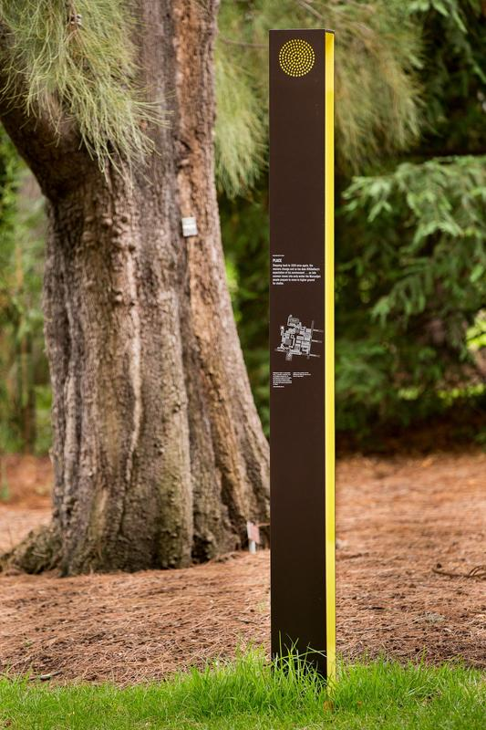
AFINet Conference 2024 Systemic approaches and decolonising the service system
Skye Stewart, Manal Shehab
Dr Jacqui Sundbery
Notes:
Introductions:
My name is Skye and I’m Jacqui! Skye- I’m a Wergaia and Wemba Wemba midwife, mumma of 6. I work alongside Jacqui at the University of Melbourne on some really important projects around Aboriginal families healing from complex trauma in the perinatal period. Jacqui – I am a second generation settler and grew up on Dharwal, river Country, in Sydney, Australia. As you can all read our bios I won’t repeat them though important to recognise our own lived and living experience and yours too! Skye, Manal and I have been impacted by partners and family members and friends substance misuse and Skye and I have had our own experience of substance misuse.
Jacqui - Please do look after yourselves during this presentation and should you feel have strong feelings arising. Ground yourself, in your body, breath and senses and use the opportunity to acknowledge a part of you that may need attention and healing.

Slide 3
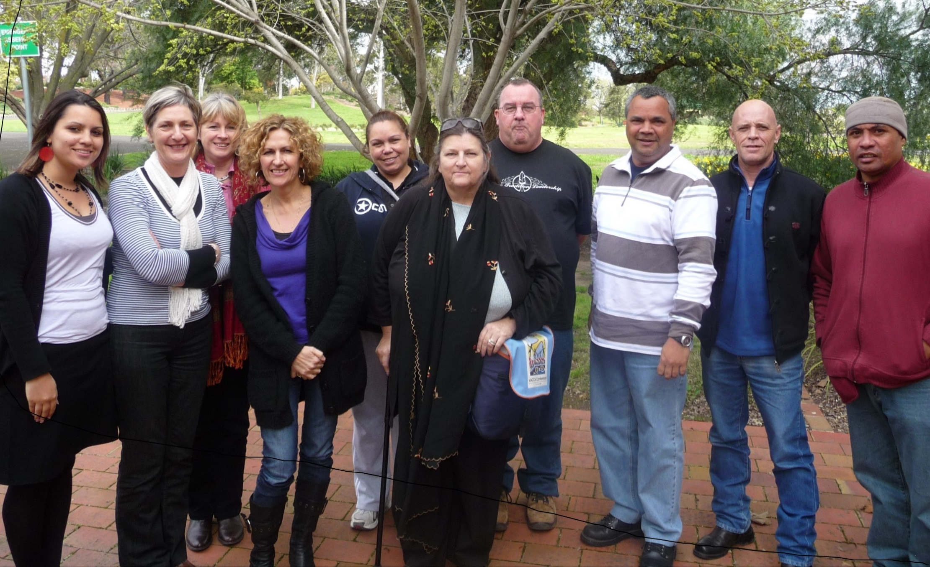
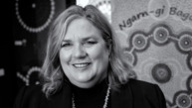
The Metro Mob
Cath Chamberlain
Professor of Indigenous Health
Melbourne School of Population and Global Health
Notes:
Jacqui – I'd also like to acknowledge the co-researchers I have worked with and whose knowledge I will share with you today. The metro mob walked alongside me during my PhD research and Cath Chamberlain leads the unit that Skye and I work in and informs how I understand IHE and SEWB

Slide 4
Overview
Understanding health from Aboriginal and Torres Strait Islander perspectives
Impacts of colonisation
Health sovereignty
Principles of culturally secure service provision
Notes:
Jacqui: today we are hear to speak with you about what it means to decolonise the system with Aboriginal and Torres Strait Islander people and for those marginalised communities who find access to mainstream services difficult
We’ll be sharing the time and the space with each other today. Skye and I will spend time talking about what’s important to ensure self-determination within service settings where there is the problem of alcohol and other drugs. Manal will then talk about the synergies and cross overs in her work with migrant and refugees communities at Muslim Youth Adult Family Services here in Melbourne Australia.

Slide 5
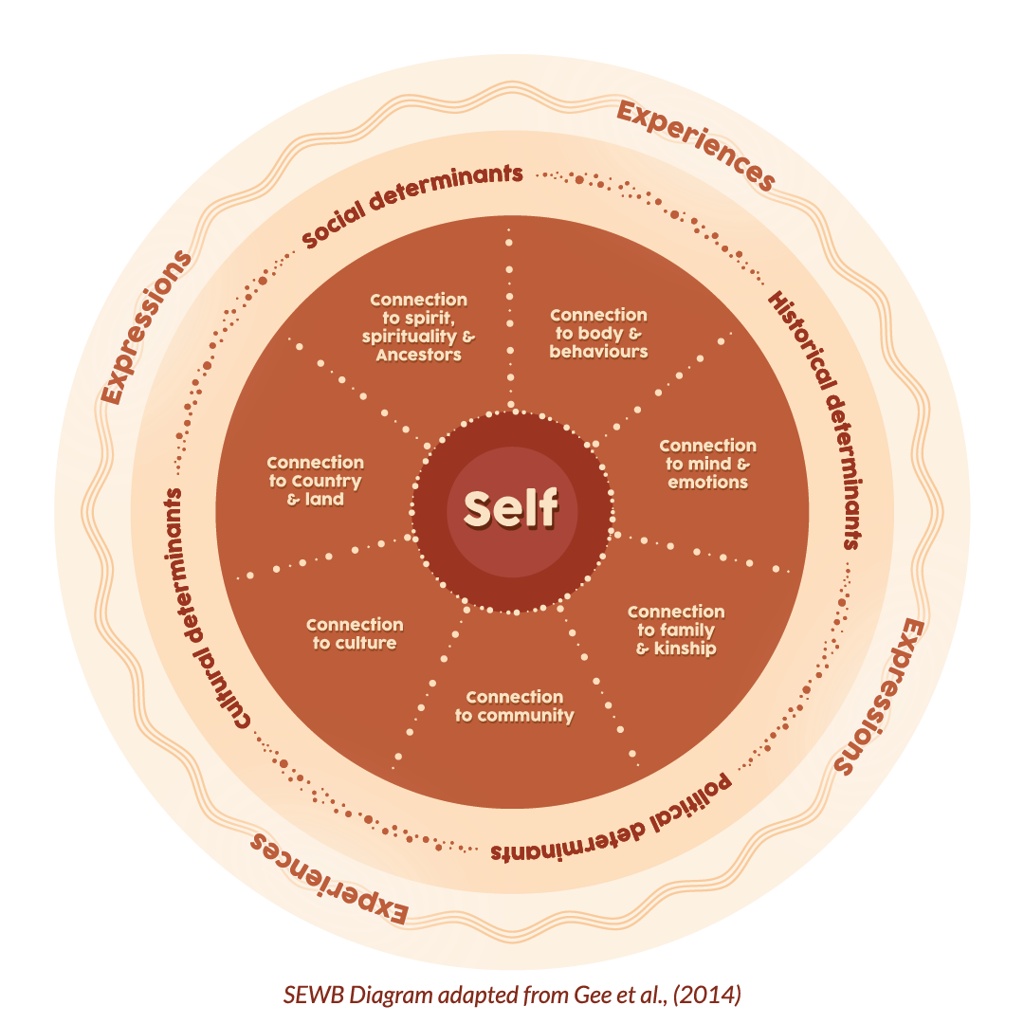
Aboriginal and Torres Strait Islander children’s social, emotional and physical wellbeing has been nurtured for millennia.
Social and emotional wellbeing is a conception of self which is grounded in and shaped by connection to family and community.
SOCIAL AND EMOTIONAL WELLBEING
Notes:
Skye-
Its important to understand that prior to colonisation, Aboriginal and Torres Strait Islander peoples had adapted and thrived in Australia for at least 60,000 years. There were over 500 Aboriginal and Torres Strait Islander countries, each with sophisticated laws and systems and ways of being, as well as thriving art and spiritual culture. Available evidence suggests that, around 1788, Aboriginal and Torres Strait Islander people and children were healthier than most Europeans of that time. This state of wellbeing, centred around connectedness, was fostered within systems of kinship and community care for millenia.
SEWB for Aboriginal people emphasises connections to body and self; mind and emotions; family and kin; community; culture; land; and spirit and Ancestors. SEWB framework was developed by Dr Graham Gee and colleagues. And we think there's a lot we have as one of the world’s oldest continuing cultures to share about ways to foster connections and relational wellbeing.
(this sets the context for understanding holistic health needs and supporting Aboriginal ways of knowing being and doing in service systems. Consider how Tikanga have been incorporated into the legal system in Aotearoa…prior to the arrival of Europeans in Aotearoa New Zealand, for a thousand years Māori had developed well-established social structures, and systems of accepted rules and conventions by which their societies were regulated and governed. Commonly referred to as ‘tikanga’, these rules and conventions related to all aspects of communal life including, for example, family relationships, property, conflict resolution, trade and land rights, and protection of the environment. What could tis look like for the provision of services related to problematic substance use? )

Slide 6
Impacts of Colonisation
Notes:
Jacqui
The ongoing impacts of colonisation place Aboriginal and Torres Strait Islander Australians at increased risk of harms from AOD use (Australian Institute of Health and Welfare, 2022a). Because of colonial genocidal actions like state-sanctioned massacres, the First Nations population went from an estimated 1-1.5 million before invasion in 1788 to less than 100,000 by the early 1900s. This history has included dispossession, loss of autonomy, racism, social exclusion and assimilationist policies that provided a legal framework for the removal of children from families. This history does not account for all the factors contributing to drug and alcohol misuse by Aboriginal people but the way substances have been used can be seen in response to this history
Skye – framing what’s useful and not so helpful around framing around trauma and social inequity
Linda Tulawai-Smith (1999) has commented that framing substance misuse as a result of social inequity can help to remove social stigma and blame so that drug and alcohol issues are seen not to be just individual or community problems but rather ones that need to be understood in a broader context. This assists in empowering individuals can be a part of communities taking control of how their problems are perceived and treated. Many Indigenous activists from different parts of the world have argued that mental illness, alcohol and drug problems and suicide are primarily a result of colonisation or lack of collective self–determination (Smith, 1999). Having this understanding tells us that self-determination is key to providing health and healing for Aboriginal peoples.
(Other commentators (Langton, 2012; Pearson, 2007) believe this approach has operated to place Aboriginal people in a position where their agency is reduced through focussing upon overwhelming structural disadvantage and an inequitable and traumatic past.)

Slide 7
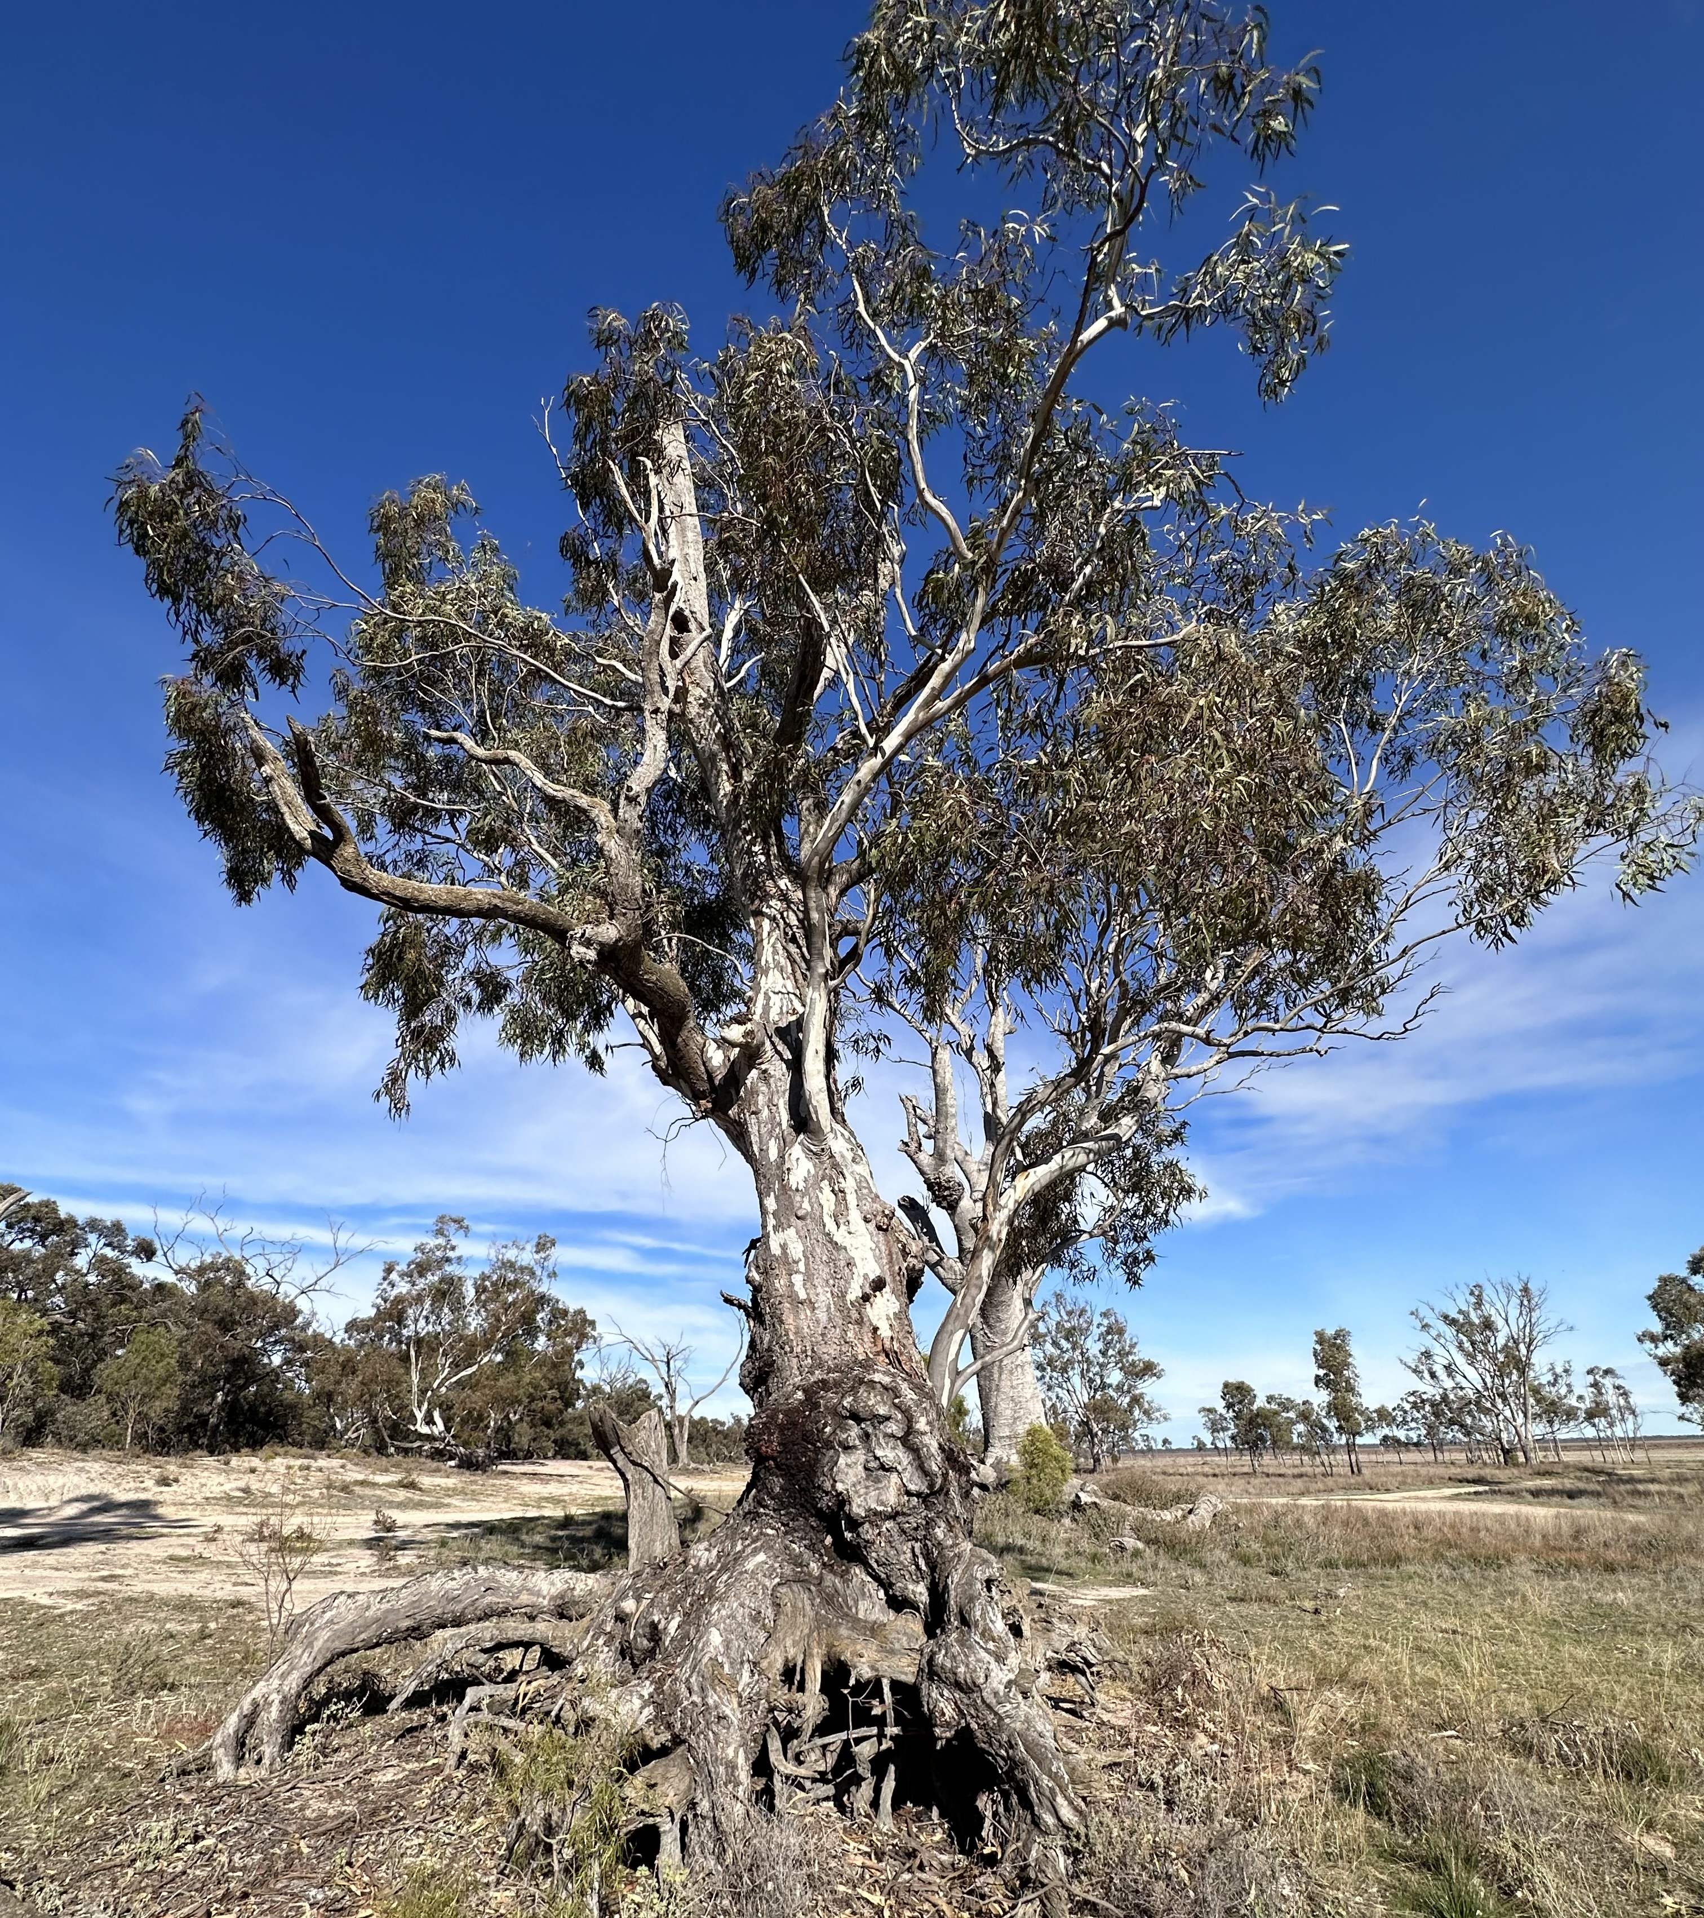
How much of a problem are drugs and alcohol for Aboriginal and Torres Strait Islander people?
Notes:
Jacqui - Alcohol: Several surveys, though not all (Zheng et al., 2021), have reported that Aboriginal and Torres Strait Islander Australians are less likely to drink alcohol at all in the past year than are the remainder of the population; but when they drink are more likely to consume amounts that could place them at short term risk (more than four standard drinks per day)
Illicit drug use: In national surveys, cannabis is the most common recently used illicit drug (reported by 16% of respondents) followed by strong pain relievers (not over-the counter) and opioids (5.9%) (Australian Institute of Health Welfare, 2020). A review of methamphetamine use among Indigenous Australians, found that the use of, and harms associated with methamphetamine are more prevalent among Indigenous Australians than non-Indigenous Australians. Som of the harms associated with drug use such as suicide and hospitalisation have increased evidenced over the decade to 2018–19 where the rate rate of drug-related hospitalisations for Indigenous Australians increased by nearly 2.5 fold (144%, based on linear regression), compared with under one-fold (29%) for non-Indigenous Australians. The degree of harm and usage is different as is the use of services by Aboriginal and Torres Strat Islander people.
Skye - Aboriginal and Torres Strait Islander people do not always have the same level of access to health services as non-Indigenous Australians. Disparities in use of health services may indicate problems with access to health services, such as:
availability and distance travelled, especially in remote and very remote areas
affordability
cultural appropriateness
previous experiences of racism in health care environments for themselves, family or community members.
In 2018–19, of the 243,663 Indigenous Australians who did not access health services when they needed to, 32% indicated this was due to cultural reasons, such as language problems, discrimination and cultural appropriateness

Slide 8
Aboriginal identity, alcohol and drugs
There is something where you are drawn to your people, for him it was like drinking in the park and I’d say, why? And he’d say, that’s where my friends are, that’s where my people are - that’s what it’s about.
I’ve come back to Melbourne to meet my family but they won’t accept me…I started drinking so that they would accept me and they still wouldn’t…and then I started doing drugs so they would accept me and they still wouldn’t…and now I’m a drug addict and I’m homeless and I’m Aboriginal and I don’t know what that means to me!
Notes:
Jacqui – as a result of dispossession, disconnections, stolen generations and the way alcohol and other drugs were denied to Aboriginal people, and then granted alongside citizenship in 1967 helped to created unhealthy identities and cultures around drugs, alcohol, gambling and nutritionally poor food. These quotes from Aboriginal AOD workers highlight this...
There is a perception that not drinking means the individual is trying to `be better than’ or trying to forget his or her Aboriginal identity by being a teetotaller (Phillips, 2003).
This second quote is from a person who was part of the Stolen Generations
These quotes speak powerfully about the need for healing cultural connections.
Skye – yes and…

Slide 9
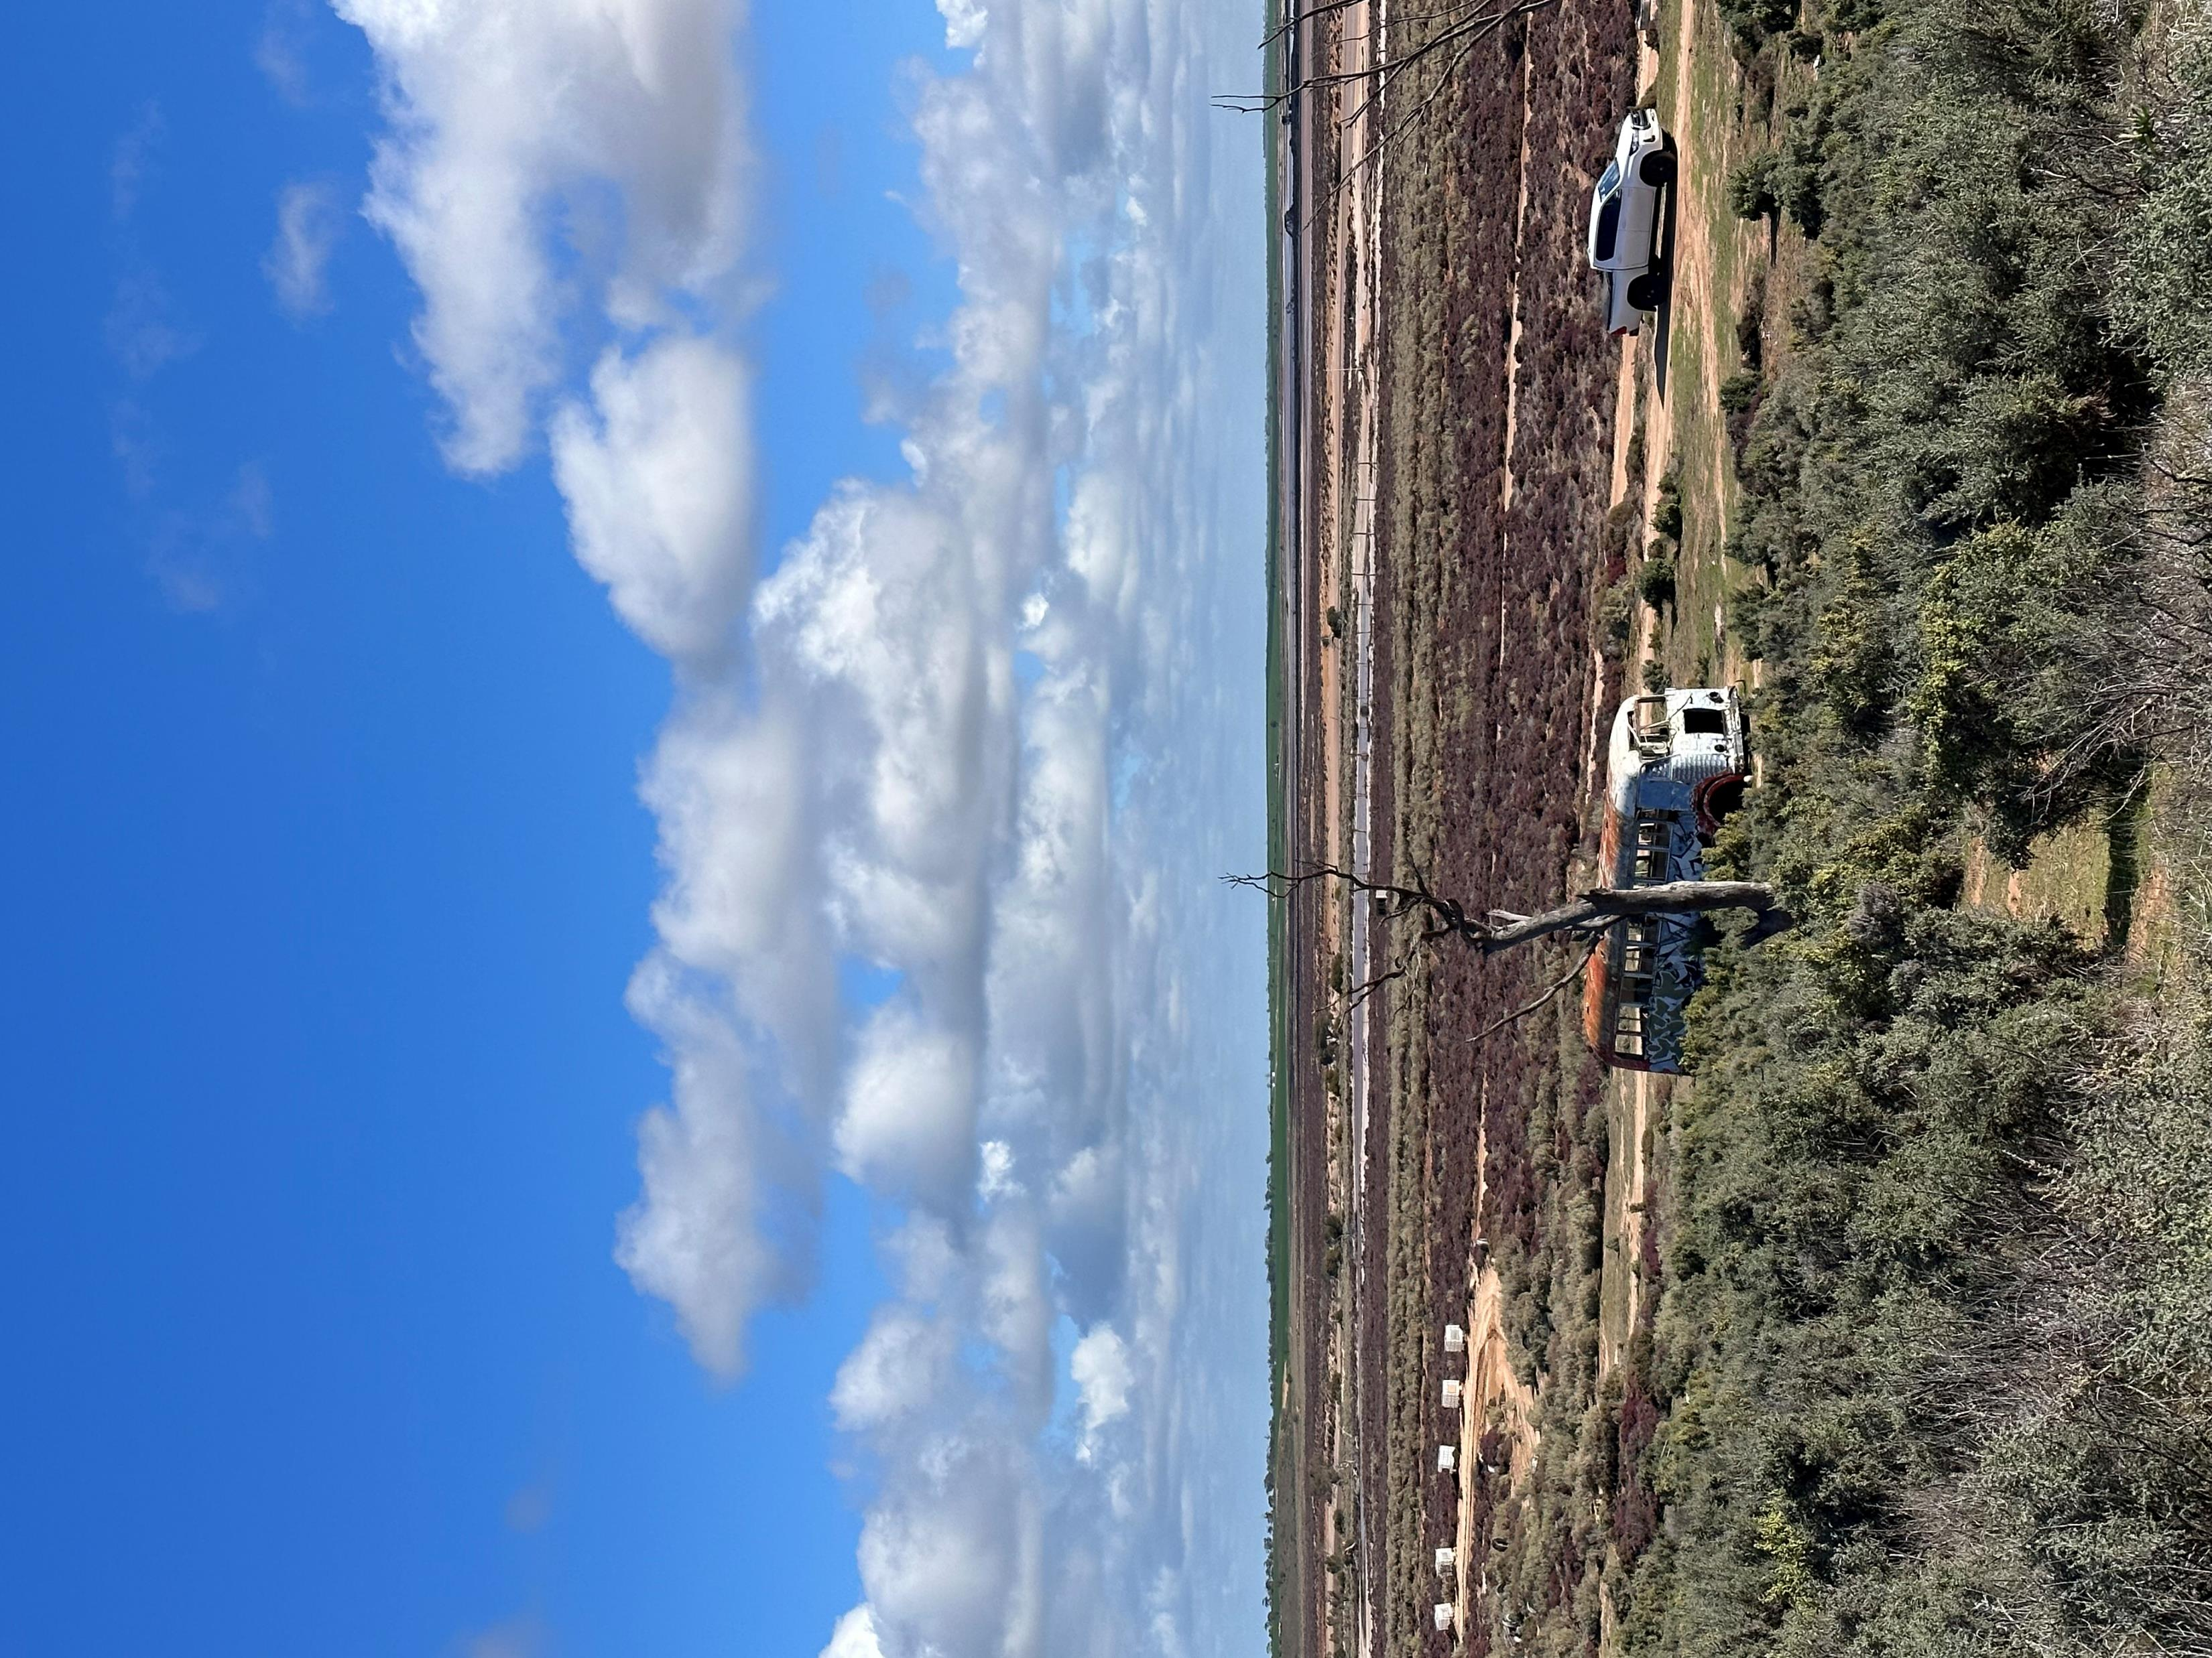
Connection to Country
Notes:
Skye
In my own story of alcohol misuse, I avoided mainstream health services like the plague to seek support. Factors that prevented me from accessing mainstream services was due to both intergenerational trauma and Complex PSTD – most of this to do with idea that if I disclosed alcohol misuse, I would be labelled ‘a drunk black’ and have my children removed from me.
The one time I was brave enough to, I went to my GP and asked if I could go on naltrexone. She responded gently by saying I would need therapy to go hand in hand with it. She doesn’t want to give me the medication and “leave me out in the wild” with no coping mechanisms, as she could see alcohol was my coping mechanism. It was a fair point but in that moment I felt a further sense of “no one understands me even when I am telling them exactly what I need”.
At some point, I decided to move back to my Country, my Aboriginal Country in Australia which is Wergaia Country. My plan was to stay for 6 months to be closer to my Mum, who was unwell at the time and to also just get out of the city for a bit.
What ended up happening in this time was a deep Ancestral connection to my home land that was a potent catalyst for healing. Most days I would go out to Lake Tyrrell, which was a sacred lake of my people and just be. I would sit and watch the sunset, walk on the salt and just breathe. There was something so connective in these moments that reminded me that I wasn’t alone. Over some months of doing this, my alcohol use was barely non existent. My relationships had changed. Some had gone completely, others were reawakened and new ones flourished. The connections to my family and community had shifted and my relationships with my children became better. I was stronger in myself. I even liked myself.
I share just this tiny snippet of the story today because it is important to acknowledge that ways of healing and recovery can vary so widely. I share it because for me, as an Aboriginal person and mother, culture was my protective factor and my ways of knowing, being and doing were at the heart of my healing and recovery. Whilst it wasn’t just sitting on the old salt lake that magically cured me, it was the fact that I found Country as my “support source” and “connection” that I could draw everything from. For me, every day was a deliberate act - Country as my mentor and support, it was the foundation that supported me to not misuse alcohol. Because of this, I was able to start looking at other areas in my life where my the health and wellbeing were at stake. It meant over time I was reassessing my relationships, setting healthy boundaries. Some things that seemed impossible, just weren’t anymore. When one thing started balancing in my life, it would flow on to the next. I was feeling strong and connected and that my cultural way of doing things was the right way for me. I didn’t feel as though I had to hide who I was. I started having a stronger connection to my body, behaviours and emotions. Like we saw earlier with the SEWB wheel, there are many aspects to our wellbeing and how we view ourselves as ‘being well’.

Slide 10
Health as a sovereign issue
Notes:
Skye
So considering Aboriginal and Torres Strait islander understanding of health how does this translate in terms of service design and delivery?
Firstly a bit of background on what is meant by health sovereignty:
Health sovereignty is about recognising, respecting, and promoting the self-determination of Indigenous people in their healthcare. It is about parents and their family being actively involved in decision making regarding their health despite the power imbalance that often exists between families and service providers.
We need to understand that the history in Australia of denying Indigenous people their sovereign rights has been directly responsible for the appalling health status we see today.
Our Indigenous peoples in Australia now suffer third world-health in a first-world country. Our babies are two and a half times more likely to die than the rest of the population. Our life expectancy is on average twenty years less. Chronic diseases such as cardiovascular disease, obesity, diabetes and renal disease, from a legacy of processed foods and dwindling activity levels, are major sources of this increased morbidity and mortality. Another major source is lack of infrastructure and resources, particularly in remote areas.[5]
Lack of access to health services is also a major contributing factor. This issue needs to be considered not only in terms of geography but also culture and history. Health professionals played an active role in the removal of children, hospitals were places where people died without their family and country, and mainstream services involved extensive institutional and individual racism.[6]
Central to achieving self-determination was acknowledging the land needs of Aboriginal people. Land rights could enable Aboriginal people to exercise control over their lives which in turn would improve their health and wellbeing (Johnston & RCIADIC, 1991; NAHSWP, 1989). For Aboriginal people health is a sovereign issue.
Jacqui
The greatest achievements in addressing Aboriginal health have been based on elements of sovereignty. Aboriginal Community Controlled Health Organisations (‘ACCHO’) are an excellent example. They are administered by an Aboriginal board that has been selected by the community the organisation services. They have developed means of dealing with individual and community health issues that are accepted by Aboriginal peoples. This can be considered to be self-determination, a fundamental, sovereign Indigenous right.[7]
Consider the outcomes during the height of the Covid 19 pandemic where ACCOs directed the response in remote communities and the results far exceeded the rest of the country
Self-determination and connection to culture and community-controlled organisations are integral factors to increase Aboriginal resilience and resistance and improve health and wellbeing outcomes (Verbunt et al. International Journal for Equity in Health(2021) 20:181 https://doi.org/10.1186/s12939-021-01514-2)
Health sovereignty is critical to service design and delivery.

Slide 11
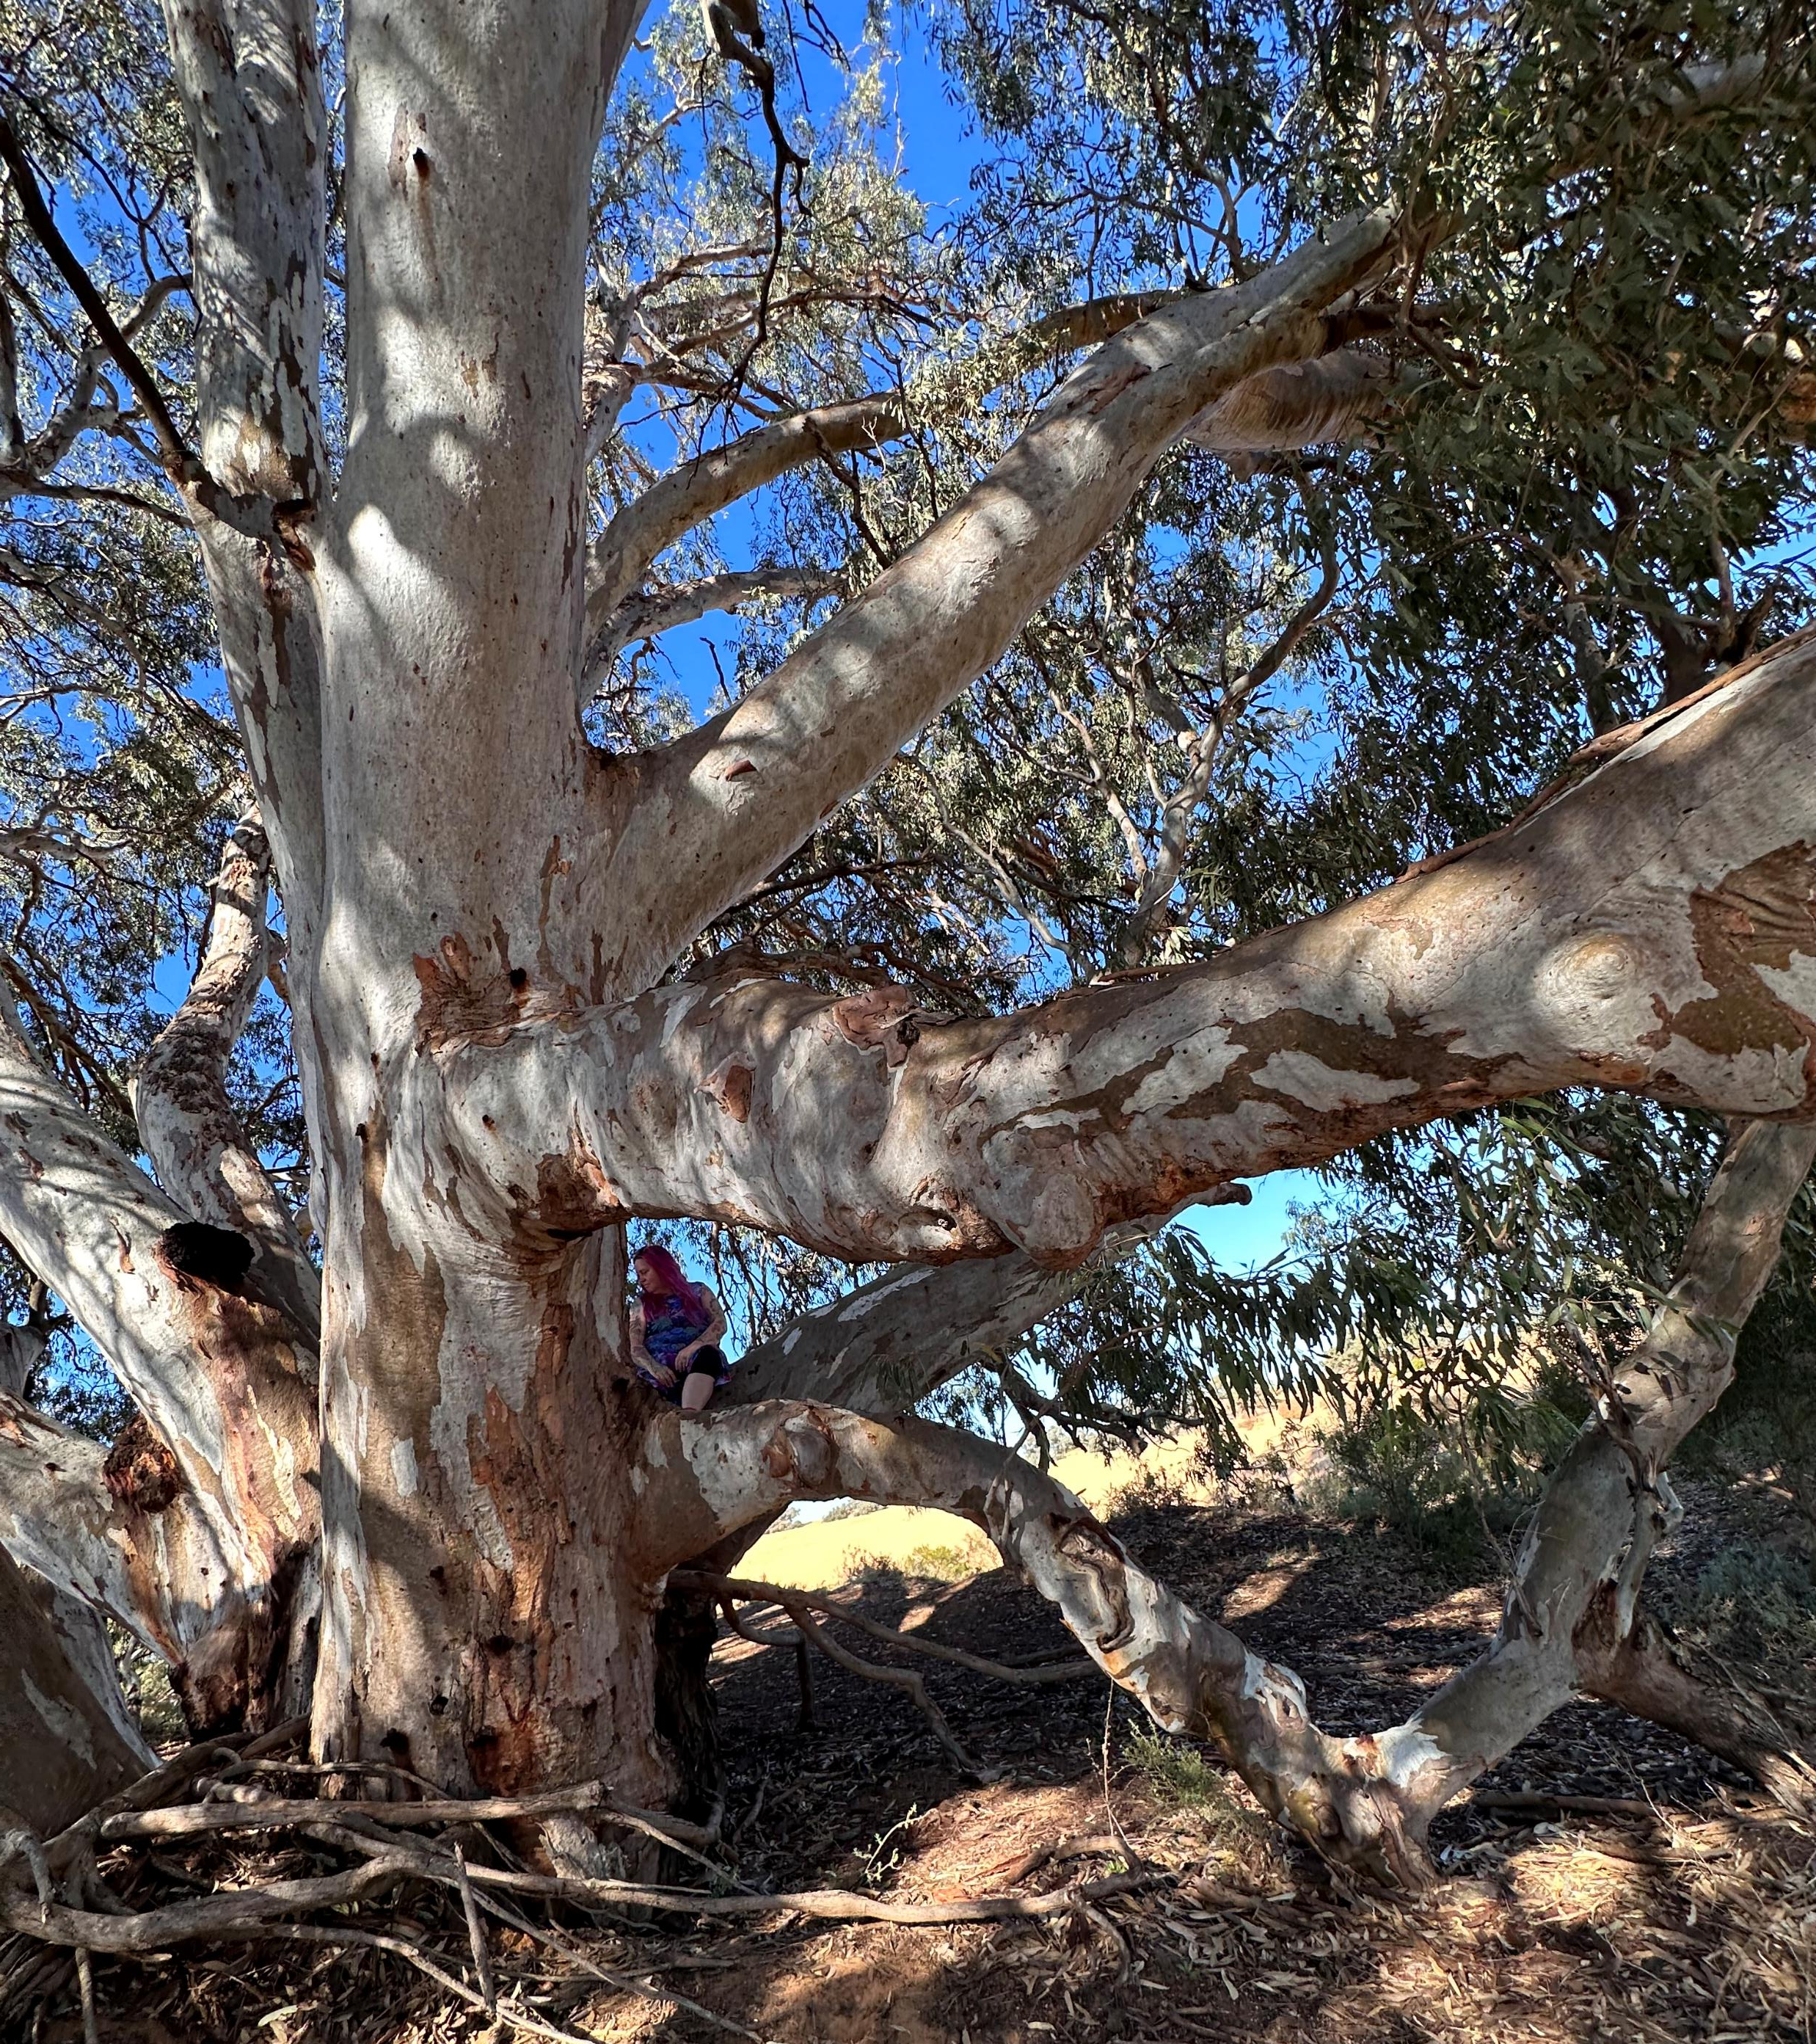
General principles of culturally secure service provision
The importance of engagement
Health incorporates social and emotional wellbeing
Cultural aspects of treatment
Adapting mainstream treatments or services
The importance of employing Aboriginal and Torres Strait Islander staff
Notes:
Jacqui – emphasise family and Community inclusion throughout these principles
- a flexible and friendly approach, with time for social yarning Access to treatment and support can be facilitated by Aboriginal and Torres Strait Islander staff including health workers, AOD workers, liaison officers (in mainstream services), peer workers and others (Gendera et al., 2022)
- treatment for problem AOD use should be holistic wherever possible – where physical, mental health and social needs are all considered (Purcell-Khodr et al., 2020). This treatment can build on strengths of the individual, family, community and culture (Gendera et al., 2022).
Provision of AOD treatment or care within a primary care setting can facilitate integrated care (Freeburn et al., 2021). Where specialist AOD treatment services are also needed, the primary care service can help ensure continuity of care.
- Many treatments for problem AOD use (e.g. counselling approaches, medicines) that have been shown to be effective for general populations are also used in treatment for Aboriginal and Torres Strait Islander peoples. However, a culturally secure treatment delivery approach is recognised as important This includes recognition of an individual’s priorities, such as connection to Country that Skye’s experience emphasises
- Treatment services need to be planned and delivered in partnership with local community, community controlled services and local Aboriginal and Torres Strait Islander staff from that community (Purcell-Khodr et al., 2022; Taylor et al., 2013; Teasdale et al., 2008; Williams et al., 2006).
Aboriginal and Torres Strait Islander staff can ensure culturally secure, accessible and effective treatment. Aboriginal people express a preference for an Aboriginal or Torres Strait Islander staff member to be involved in their care should they have an alcohol problem

Slide 12
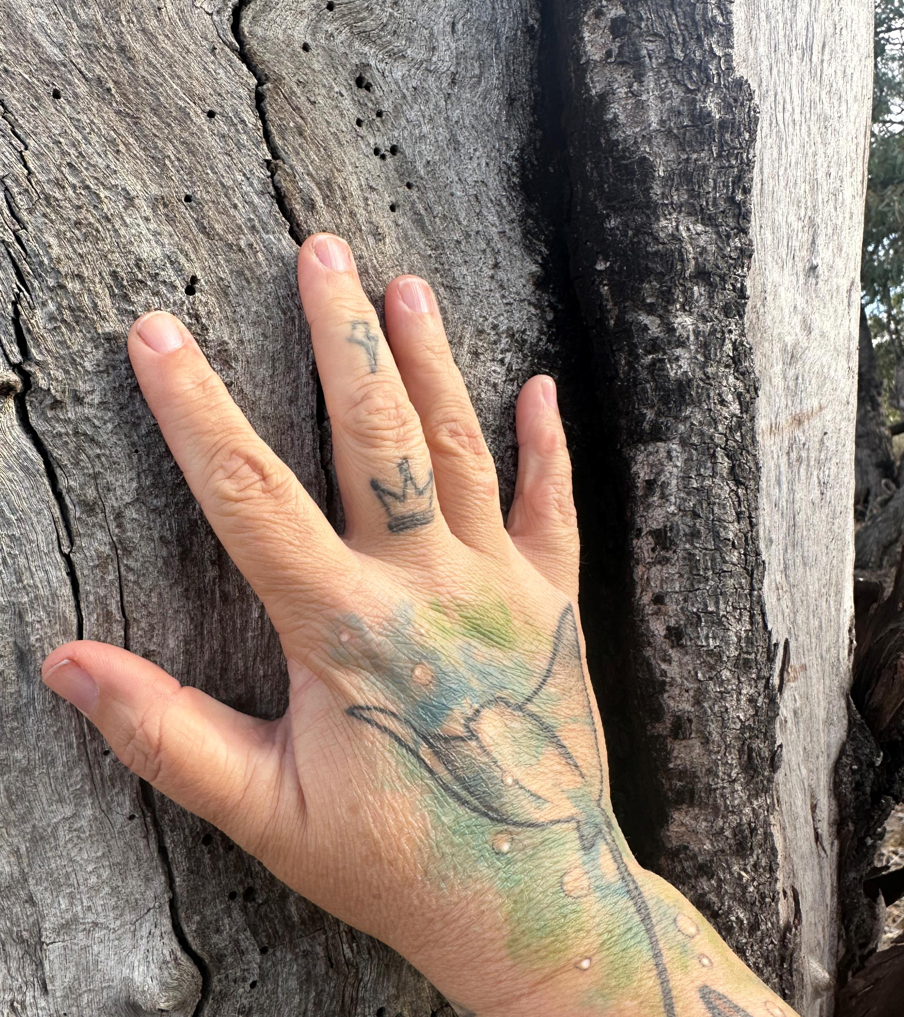
If we get it right for Aboriginal people we’ll get it right for all people….
Notes:
Our First Nations people need to come first and to lead the way in service design and provision
Manal will now reflect on how this sits alongside her own knowledge and experience

