Slide 1
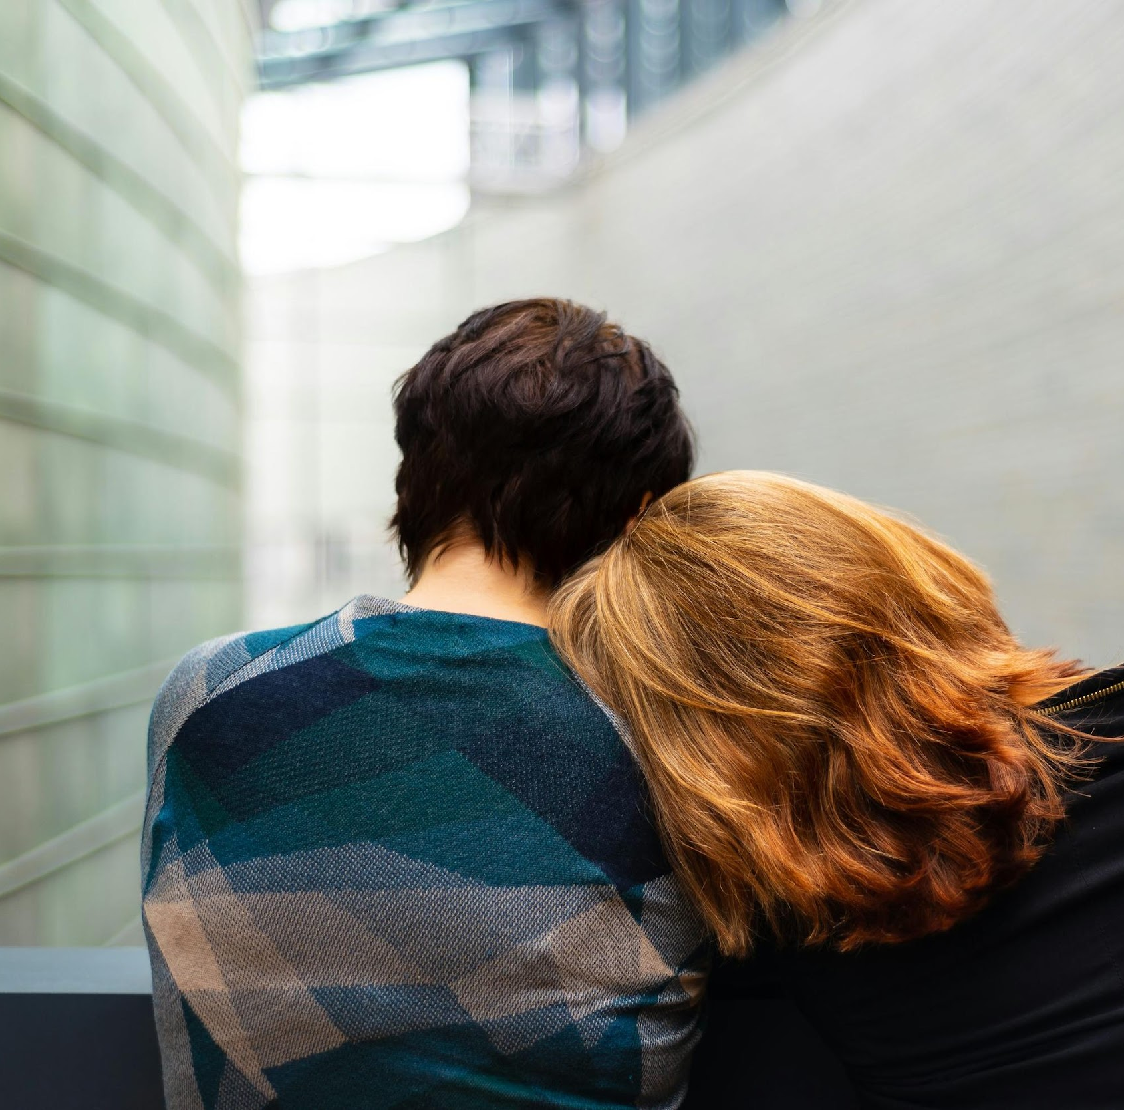
Family Counterculture and Addiction in Canada
Oona St-Amant, RN, PhD
Associate Professor, Toronto Metropolitan University
Notes:
Abstract:
Affected family members play a critical role in supporting persons with substance use disorders (SUD), yet their challenges and support strategies often remain underexplored. Through co-design with the community group Families for Addiction Recovery (FAR), this study highlights the unique perspectives and contributions of affected family members, aiming to inform more effective and inclusive policies. Utilizing Participatory Action Research (PAR) principles, this qualitative study examines the policies, practices, and laws in Canada that shape affected family members' experiences of addiction. Preliminary data analysis of in-depth, semi-structured interview transcripts with affected family members (n=87) reveals how affected family members navigate an inadequate system of care. They adopt a value system divergent from mainstream ideology to support and reduce harm for their relatives with SUD, protect other family members and the public, and prevent criminalization. Findings indicate that affected family members develop innovative strategies to address systemic gaps, such as implementing harm reduction within the home. Participants reported experiencing significant emotional and financial strain due to the lack of formal support structures. The study also highlights the pervasive stigma faced by family members, which often leads to social isolation and exacerbates their struggles. These findings reveal significant gaps in existing systems and policies, underscoring the urgent need for comprehensive system reform. Affected family members frequently navigate a complex landscape of stigma, emotional burden, and inadequate resources, all of which exacerbate their challenges. This research underscores the necessity for a paradigm shift in policy making, where the insights and needs of family caregivers are included.

Slide 2
Acknowledgements
Co-Investigators
Trainees and Research Staff
Angie Hamilton, LLB, Executive Director, Families for Addiction Recovery
Cheryl Forchuk, RN, PhD, Assistant Director at Lawson Health Research Institute, Western University
Vicky Stergiopoulos, MD, Clinical Scientist, Centre for Addiction and Mental Health (CAMH)
Brynlea Barbeau, MD, Associate Professor, Northern Ontario School of Medicine
Henry Parada, PhD, Professor, Toronto Metropolitan University
Christopher Byrne, MD, Assistant Professor, Department of Medicine at Schulich School of Medicine and Dentistry
Robert Tanguay, MD, Clinical Assistant Professor, Department of Psychiatry, University of Calgary
Jessica Mor, PhD (c), Research Coordinator
Bojan Stoiljkovic, PhD student, CIHR Trainee
Meghan Pugh, BScN student, Research Assistant
Shelby Crockett, BScN student, Research Assistant
Luwam Ermias, BScN student, Research Assistant
CIHR Project Grant

Slide 3
Background
1 in 5 Canadians will meet the criteria for SUD at some point in their lives (Health Canada, 2014) .
Addiction is a family disease, however laws, policies and practices systematically exclude family.
Significant gap between those who could benefit from treatment and those who access services (Canadian Mental Health Association, 2018).
Lack of system supports exacerbates caregiving demands for families, reinforces isolation, conflict and disease burden (Orford et al., 2010).
Affected family members seek connection against rejection and stigmatizing narratives (Rehm, et al., 2016)

Slide 4
Literature Review
Dominant representation of family as normative, framing family as either a contributor or passive recipient (Barker & Hunt, 2004).
Dichotomy of good/bad families reinforce blame and stigma, can be a decoy designed to divert attention from inadequate resources (Book, 2003).
Neglect of family in policy renders affected family members’ invisible (Velleman, 2010).
Strong cultural values influences family members deep sense of responsibility to care for their relative (Fotopoulou & Parkes, 2016).
Drug policies can reinforce the ‘responsibilization’ of family without leverage or resources (Devaney, 2017).
Courtesy stigma shapes affected family members social interaction (Flensburg, Richert & Fritz, 2022).

Slide 5
Methods
Co-designed with a community group, Families for Addiction Recovery (FAR).
Participatory Action Research Principles were used.
REB obtained by Principal Investigator.
Semi-structured in-depth interviews with affected family members between February 2024 and August 2024.
Interviews between 1 hour to 2.5 hours, via Zoom.
Purposive sampling, recruitment through FAR network as well as 8 other community organizations.

Slide 6
Sample Characteristics
Total Sample (n=87)
Affected Family Members
78 women, 8 men and 1 non-binary
78.2% from Ontario
52.9% aged between 60-69 years
90% of sample attended higher education
49.4% worked full time
34% lived with their relative with SUD
Data reported from interviews (by affected family members)** proxy data
mean age of onset of SUD 15 years
72% reported formal diagnosis of a concurrent disorder
cannabis (66%), opioids (57%), stimulants (51%), and alcohol (45%),depressants (16%) and 11% reported using other substances (e.g., hallucinogens).
Relationship of Affected Family Member (Relative with SUD) | n/%
Mother*(Son) | 54 (62%)
Mother(Daughter) | 17 (20%)
Father* (Son) | 4 (5%)
Father* (Daughter) | 2 (2%)
Sibling | 3 (3%)
Other: Stepparent, Spouse/Partner, Niece/Aunt | 7 (8%)
*includes parent with more than one child with addiction

Slide 7
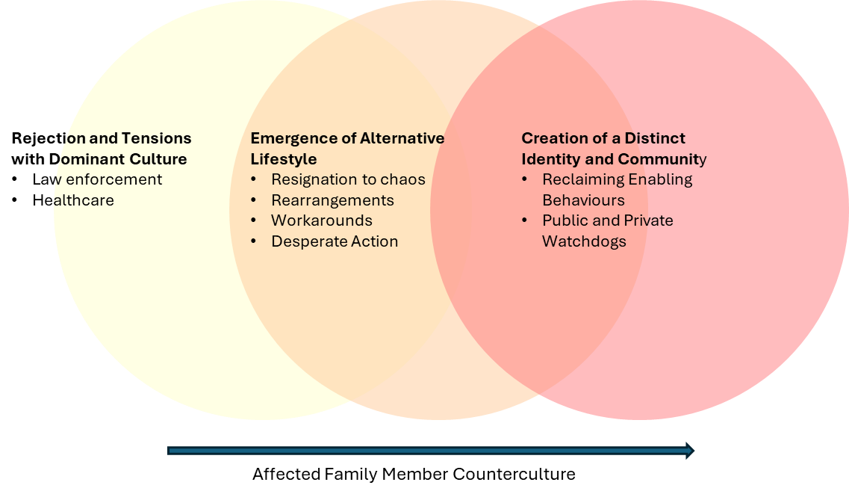
Findings

Slide 8
Rejection and Tensions with Dominant Culture
Law enforcement
Starting when there's an emergency and the world says to you to call 911, and who is 911? It's the police and who is the police? It's the criminal [justice system] and that could lead to charges. We, and probably a lot of parents, I know, because I've been on a lot of groups, do not call 911 but then we're the ones, we're victimized. We've been hurt, punched, the walls have been smashed, the windows have been broken, the house has been broken into. I've been compromised with money. He's [son with SUD] used my bank account. He's created fraud and pretended it was me for thousands of dollars, till I wondered why my bank account was depleting, and I'm retired. We could have called the fraud police. No, he'll have a criminal record. He's already acquired criminal involvement on his own, and has been removed from the record. But why would a parent do that, knowing that his records with him for life? (009)
Healthcare
So. Yes, in terms of in policies. It's just we do not have enough. Even if someone goes to detox. And they're clean for a week, 5 days a week. They’re out where they go. There's no treatment. There's no treatment for them. They're supposed to be good little girls and boys until until there's a bed open 4 months later. (042)

Slide 9
Emergence of Alternative Lifestyle
Resignation to Chaos
Now I am a prisoner in my own home, because where his room is, is between me and the laundry room, so I can't get to the laundry room. I'm trying to give him some personal space. I can't go to my backyard because I have to walk through the back family room that he lives. He spills, drinks on the floor, the sofa is disgusting. I try to vacuum from time to time. And then for the last couple of weeks, just as an example of where things are at, which is nowhere. I call his dad over, and I say, we have to clean his room. It's disgusting. We go down there while he's standing around. I don't know what you're doing. You're emotionally abusing me, and we clean up the bathroom and pick up whatever all the garbage, and wash his sheets, and there's usually loads and loads and loads of laundry that isn't done. He's wrecking my washing machine and dryer, and I usually confiscate big bottles of pills. So that's sort of where we're at current state. (071)

Slide 10
Emergence of Alternative Lifestyle (continued)
Rearrangements
I ran away in the car. You know what the police said, you don't run away, it's your house, I get it. You go home and throw him out. I said “no, I'm not, he's drug fueled, and if I throw him out, I'll be punched so I'm not throwing him out, then you're gonna pick him up and you'll charge him”, or he's gonna be on the street like, I don't want that. So he says, well, you're on the street, I said, I know, but I'm in my car and I'm safe, but I want you to send a nurse to go get him and bring him ER like it just didn't happen right? So, my husband and I stayed in the hotel like we've actually left our house for him to stay and do damage because there was no services that were appropriate for someone like him.(009)
Workarounds
And the last time she left, because I'm not getting her phone anymore, because I don't know what's happening with it [because she had previous lost phones]. She was so scared that she agreed I could put an air tag in her shoe, I bought these special insoles for it. So I went to the last place, the air tag was active yesterday, and it was a parking garage. And I walked around the parking garage, all 3 levels and in the stairwells. I couldn't find her, and I couldn't find the shoes. So then I went to the encampment and it was raining so everyone was in their tents and I didn't wanna bug anyone. (030)

Slide 11
Emergence of Alternative Lifestyle (continued)
Desperate Action
So it was like my option was, watch her die or send her to [child protective services] where they're not going to get care, because you know she has rights, and they're gonna watch her go take care drugs somewhere else, or take off and come back to the rooming house whatever, or send her to the US against her will. Those are my options. I didn't want the other options [child protective services]. So that's why we did that [chose to send her to the US]. And we had a transport team come and take her. Of course she screamed. And she's like, what are you talking about? You guys are my parents. I love you. And we're like, yeah, we love you, too. And that's why we're doing it. And here's her passport. And we signed over guardianship. That was the hardest thing I've ever done. And then she was gone for 3 months in a wilderness facility. Like out in the wilderness. So there's no roof over their heads. And then after that she went somewhere to a therapeutic boarding school for 12 months, so she was gone for 15 months. A very long time. I missed her every single day that she was gone. I said it already, I'm going to say it again, it was the hardest thing I've ever done. But also it was the best thing I've ever done. And it's going to be 10 years. She's 24 now. She's gonna be 10 years of sobriety in June. (040)
I flew in and it took me five months basically following her around trying to convince her. And then the problem was to get a passport from my daughter. Because she had lost her passport with all other ID as she did every six months. So it was a big problem to try to get a passport, then she had criminal charges. Okay, of course, all of them 100% of all drug addicts have criminal charges. They do anything necessary basically to keep up their habit. So it's anti-society, of course you can't have that. And so I had to clear all of those charges and then when I got basically a dismissal of everything, and there was a huge number of charges, then I was able to then get a passport for my daughter. And then still then I barely convinced her to get on a plane. So, my daughter, I took her out of the country. First I had taken her actually one time to Thailand, where she was off of drugs, then went back [to Canada] and immediately relapsed back on her drugs. Second time got her a passport again, because the first one disappeared. She got more criminal charges, I had to clear all of those. And the second time I was able to get her on a plane to Panama. So she is physically in Panama, off of drugs now, has a stable, nice boyfriend, and in 20 days we'll be moving into a beautiful house in the nicest area in Panama, and we'll live outside of Canada forever hopefully. (032)

Slide 12
Creation of a Distinct Identity and Community
Reclaiming Enabling
Let me tell you the funny joke about how now I can pay drug dealers by E transfer, you know like, who can I tell that to, right? Being able to talk without shame or blame, or anybody just tisking you, you know. Yeah, I think the biggest thing is feeling helpless with what to do next. So I just do my day. But I've lost a little my joy de vivre, I guess, like I've always been a happy person. But I'm tired inside (025)
Public and Private Watchdogs
But you know, I've set a whole lot of boundaries, his name is not on the passcode to get in here, so that I know when he's coming in, the gate code. He doesn’t get a key, there's a curfew unless we discuss it in advance. I check him at the door for drugs. I check his room and he's still trying to do all this stuff. (075)

Slide 13
Discussion
Counterculture emerged over years.
Counterculture occurred along a trajectory.
From the perspective of the family, there is an overreliance on their grit, perseverance and willingness to tolerate chaos, with dire consequences (e.g., unhoused, sexual exploitation, death).
This overreliance (re)centers blame and courtesy stigma.

Slide 14
Implications
Drug policies
Health policies and practices
Law enforcement
Future research

Slide 15
Questions
ostamant@torontomu.ca

